Slide 1

Intro To Raspberry Pi
UTA EE Workshops

Slide 2
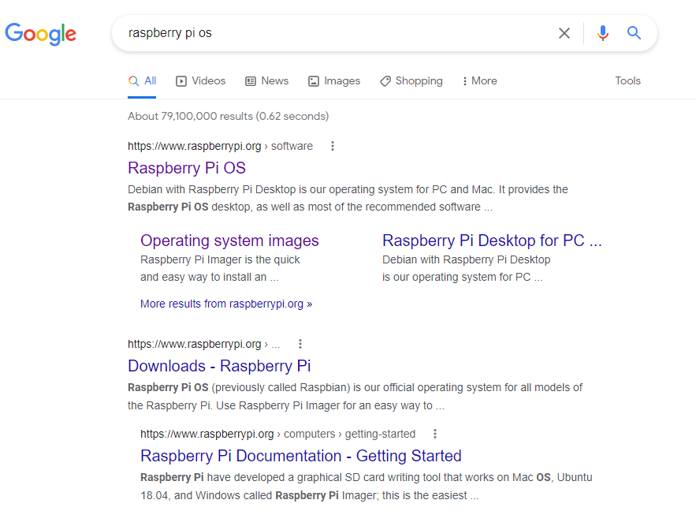
How to format the SD card
Search for Raspberry Pi OS

Slide 3
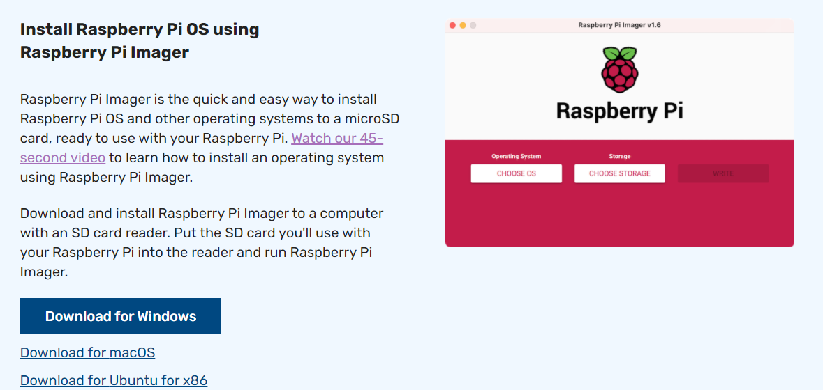
Download the installer for your system
This will install the latest SW
You have to download a huge file for previous versions.

Slide 4
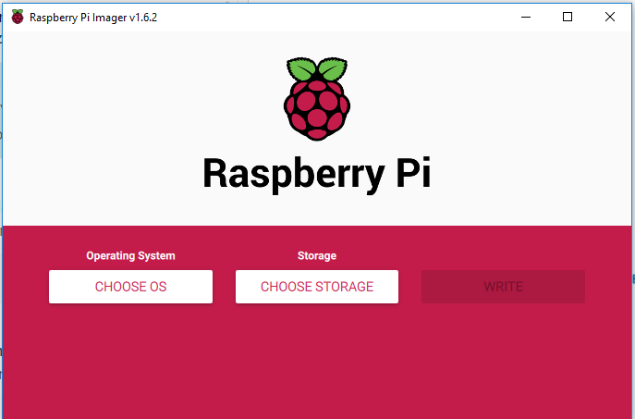
Open Raspberry Pi Imager

Slide 5
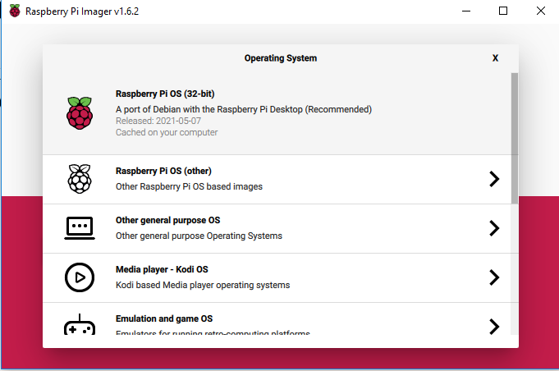
Choose the Raspberry Pi OS (32-bit)

Slide 6
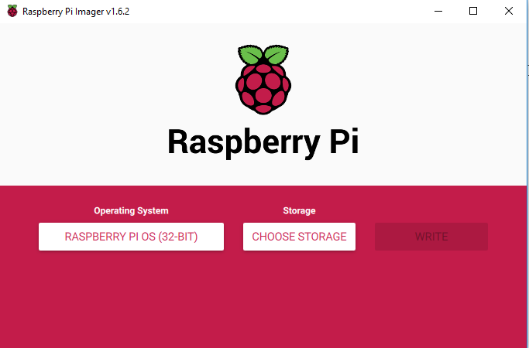
Plug the SD card into your computer and select Choose Storage.

Slide 7
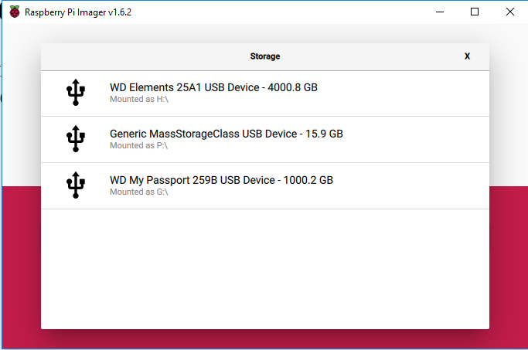
SD card is P:\ on this system. Verify in Explorer. THIS WILL ERASE EVERYTHING ON THE CARD

Slide 8
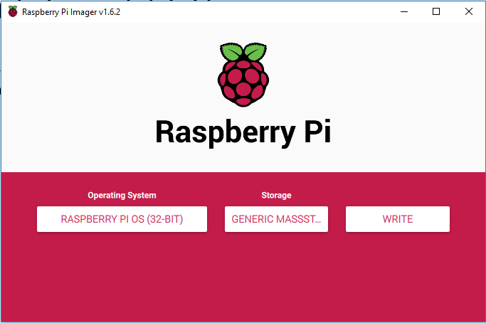
Click Write

Slide 9
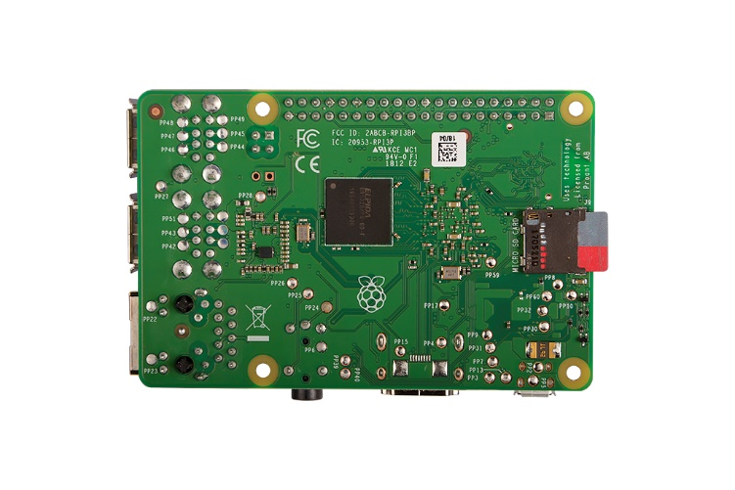
Insert Micro SD into Raspberry Pi.
Wrist-straps not required but touch metal on the Rpi USB to dissipate ESD.
Be careful not to touch the Micro SD card pins.
Never place bare board on metal surface.

Slide 10
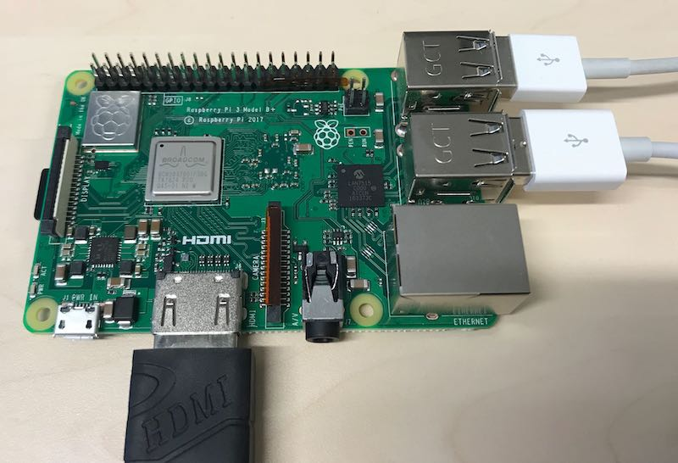
Connect Mouse, Keyboard and HDMI
Be gentle
RPi 4 will need the HDMI to HDMI Micro adapter. Plug into HDMI 1

Slide 11
Connect Network Cable
Disconnect the network cable from the back of the bench to the computer and plug in the 7 foot network cable into that network port and the RPi.

Slide 12
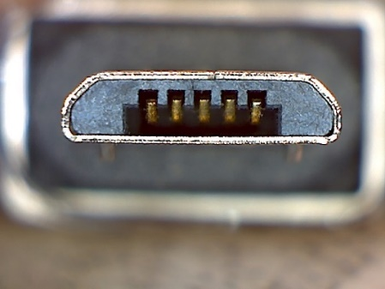

Connect Power
Again Gentle.
3B+ has directional USB Micro.
Rpi 4 has USB C and can plug in either way.
Ensure the Display is on HDMI input then
Go thru the set up. Chicago TimeZone,
Username is pi
Password is raspberry
This is the standard username and password.
USB - Micro
USB - C

Slide 13
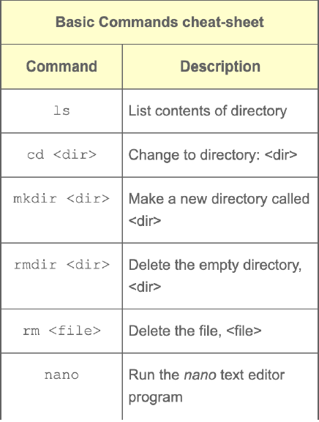
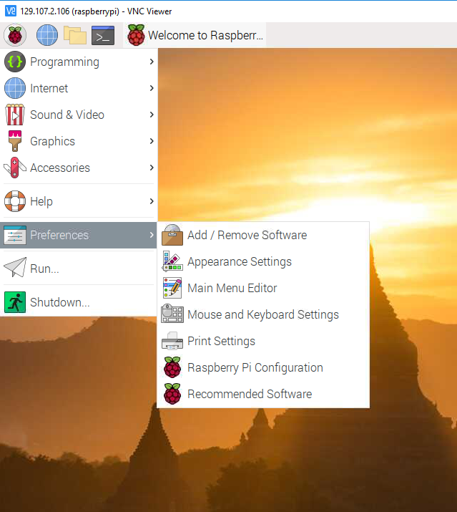
Terminal Commands
Open the Terminal window >_
This is Linux command prompt
Let’s see what these commands do

Slide 14
Don’t want a display, keyboard or mouse duct taped to your project?
Real VNC
Download https://www.realvnc.com/en/connect/download/viewer/ and install on your computer (not the Pi)
On the Pi: Preferences->Raspberry Pi configuration. Interfaces Tab: Enable VNC.

Slide 15
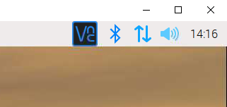
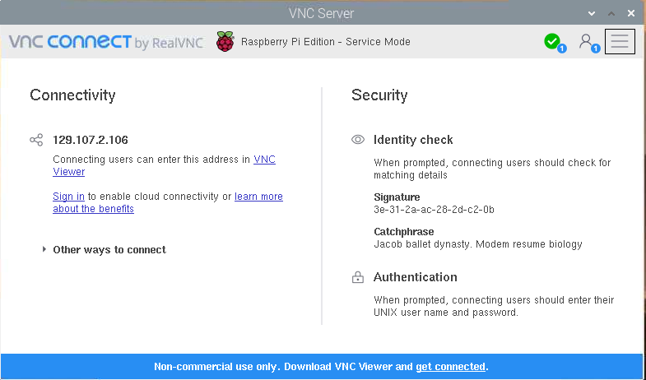
Remote control Baby!
Click the VNC button in the upper right
This will give you the Pi’s IP Address.
Open Real VNC on your laptop and enter the address.
Computer name is pi and default password is raspberry.
This should allow you to remotely control the raspberry Pi.

Slide 16
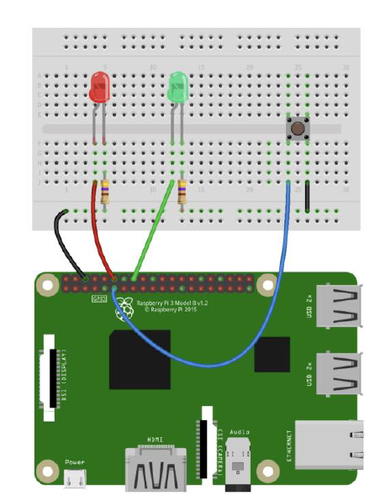
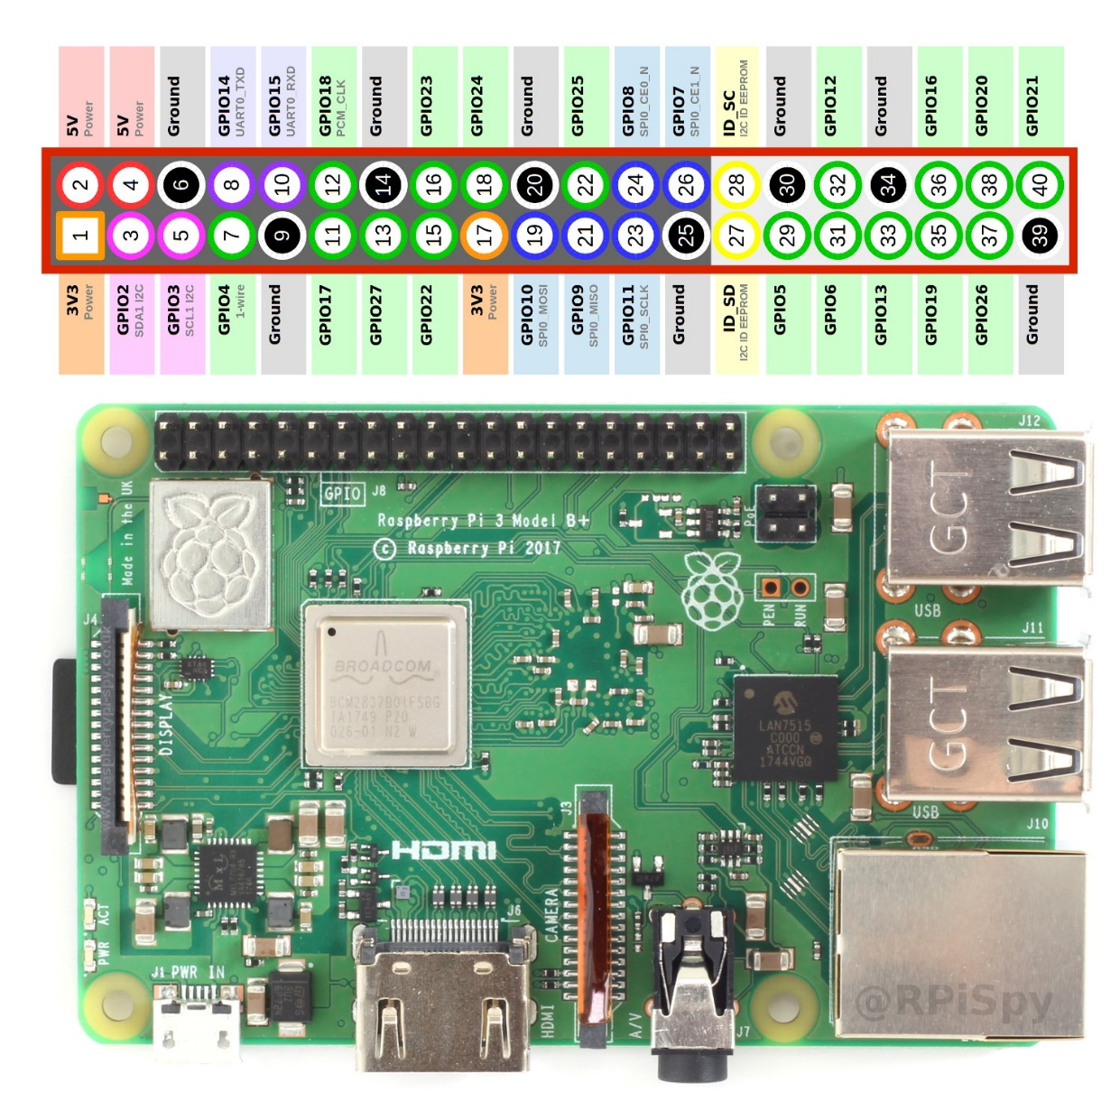
Blink an LED in Python.

Slide 17
Open Geany from the programming menu
Download the Button Blink PWM code.py code from the GitHub page and paste it into Geany.
Save the file as Button Blink PWM code.py
Geany can program in several languages, so the .py indicated a Python Program.
The interesting fact is that the programming language Python was implemented by Guido van Rossum.
Whilst Guido van Rossum was implementing Python, he was also reading the published scripts from Monty Python’s Flying Circus.

Slide 18
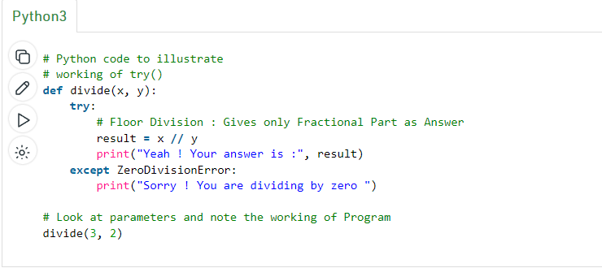
Try / Except
A simple Python function

Slide 19
Button Blink PWM code.py
try:
while 1:
if GPIO.input(butPin):
pwm.ChangeDutyCycle(duty)
GPIO.output(ledPin, GPIO.HIGH)
#Pressed
else:
GPIO.output(ledPin, GPIO.LOW)
for dc in range(1, 101, 1): # Increase duty cycle: 0~100
pwm.ChangeDutyCycle(dc) # Change duty cycle
time.sleep(0.02)
for dc in range(100, 0, -1): # Decrease duty cycle: 100~0
pwm.ChangeDutyCycle(dc)
time.sleep(0.02)
except KeyboardInterrupt:
pwm.stop()
GPIO.cleanup()
import RPi.GPIO as GPIO
import time
#pin definitions
pwmPin = 18
ledPin = 23
butPin = 17
duty = 10
##GPIO setup ##
GPIO.setwarnings(False)
GPIO.setmode(GPIO.BCM) # BCM way of referring to pins GPIO.Board uses pin numbers
GPIO.setup(ledPin, GPIO.OUT)
GPIO.setup(pwmPin, GPIO.OUT)
GPIO.setup(butPin, GPIO.IN,pull_up_down=GPIO.PUD_UP)
pwm = GPIO.PWM(pwmPin, 1000) # PWM frequency in Hz
GPIO.output(ledPin, GPIO.LOW) # default off
pwm.start(duty) # start at 75%
Notes:
# https://sourceforge.net/p/raspberry-gpio-python/wiki/Examples/
GPIO BCM (GPIO.BCM) is the Broadcom Soc Channel numbering
GPIO board (GPIO.Board) is the pin reference numbering system

Slide 20
Stay tuned
In the Second Raspberry Pi workshop we will build a Sound Board and do more Python programming…

